Slide 1
Music and Sound
Waves weeeeeee

Slide 2
Hehe hw review bc I forgot to do it last week

Slide 3
Intro to waves

Slide 4
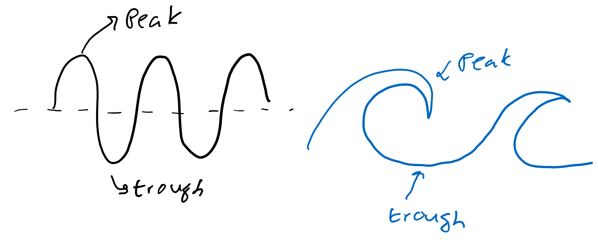
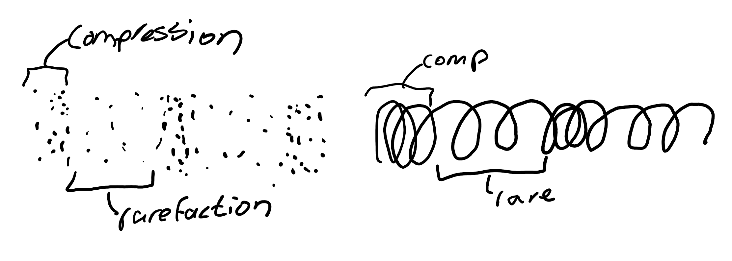
What does a wave look like?
Transverse waves: they do the up and down vroom, drop, vroom, drop, etc.
Longitudinal waves: they do the back and forth, squish, unsquish, squish, unsquish, etc.

Slide 5
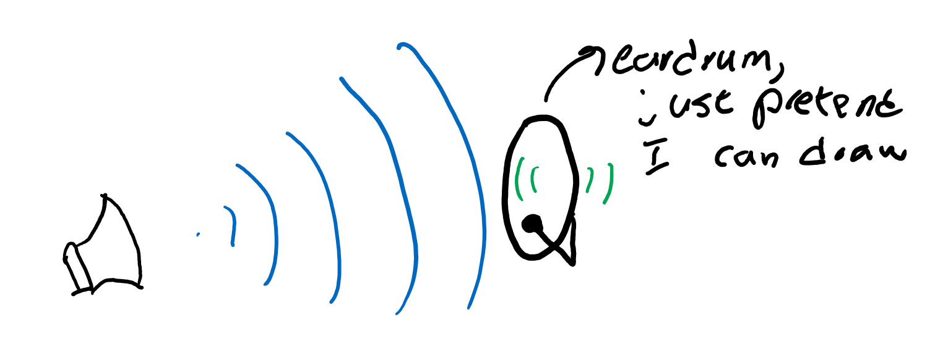
Which one is sound?
When sound hits my eardrum, it vibrates it back and forth. So. . . which type of wave is it?

Slide 6
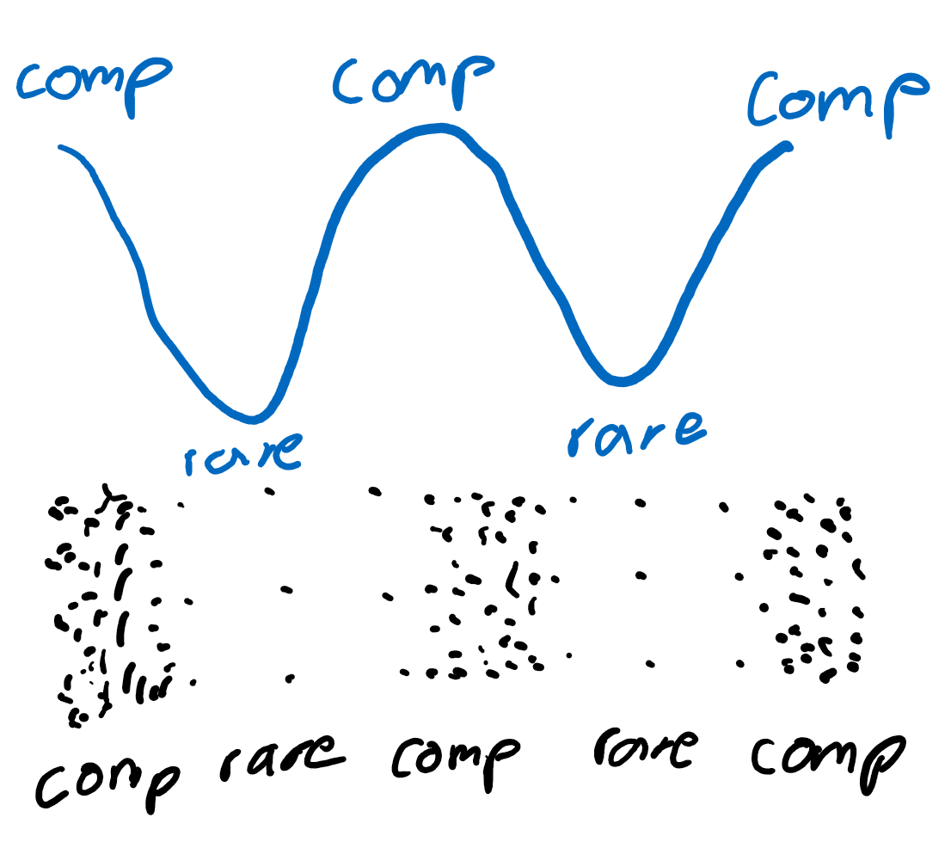
Expressing longitudinal waves
Compressions and rarefactions are hard to show on paper, so we can draw longitudinal waves in a way similar to transverse waves!

Slide 7
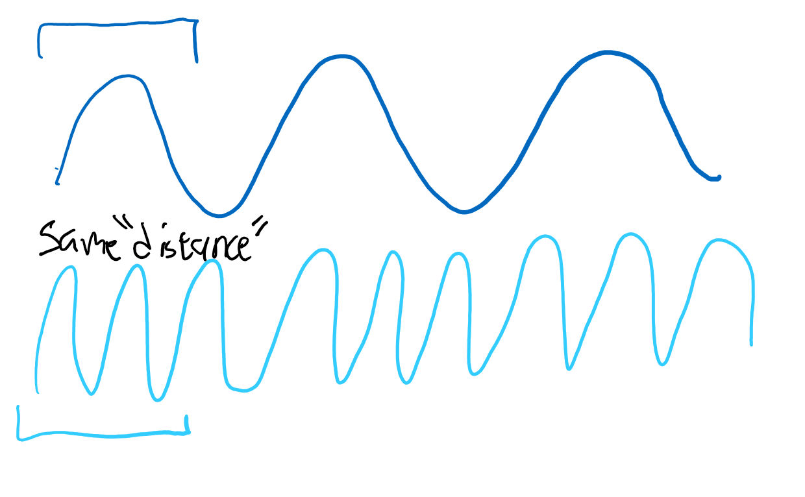
How fast does a wave travel?
Speed? Sounds like distance over time to me.
So, how do we calculate “distance” for waves?
What does number of “squiggles” times length of “squiggle” give us?

Slide 8
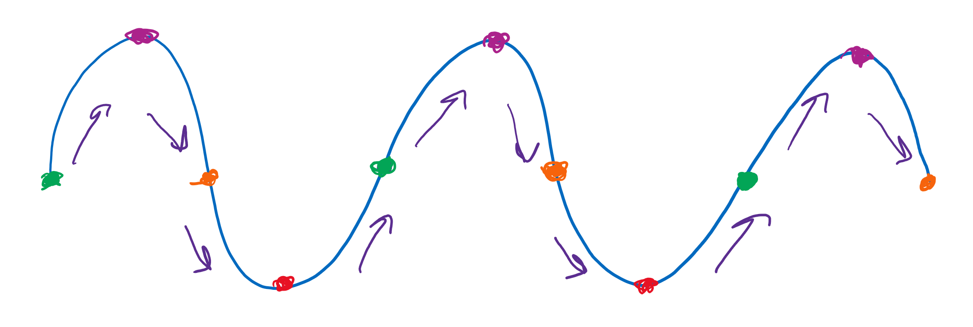
What is a “squiggle?”
A squiggle (cycle) is the segment from the same color to the next same color (aka, red to red or orange to orange to orange). After one cycle the next cycle looks the exact same. Repeat repeat repeat.

Slide 9
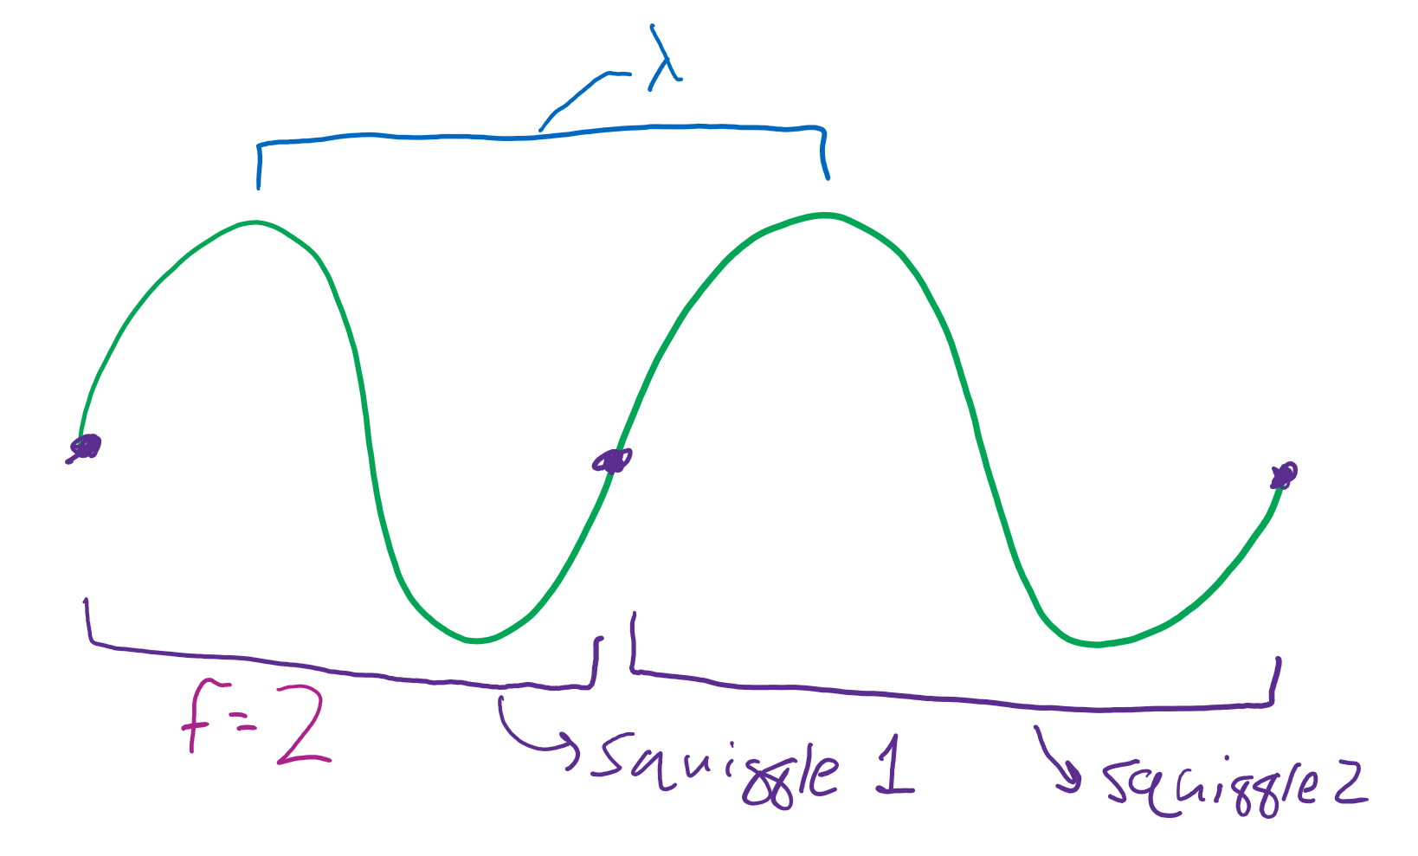
New terms
Frequency (f): number of squiggles per second. Measured in “hertz.” Units for “hertz” is 1/s.
Wavelength (λ): length of squiggle. Measured in meters.
Thus, f*λ has units m/s, just like speed omg!

Slide 10
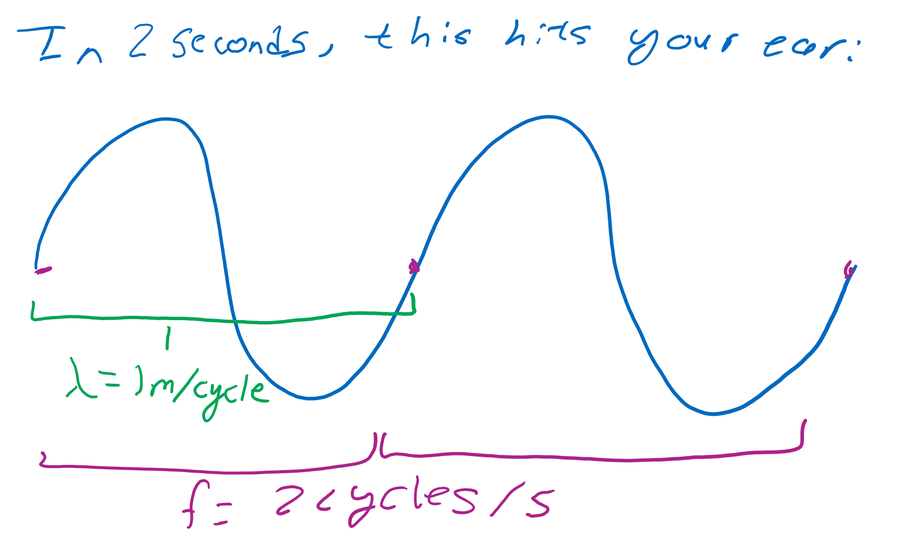
More about the two
Wavelength: measured as the distance between peaks or distance between troughs. Also the length of a cycle.
Frequency: how many cycles occur in a given time; aka, # of cycles divided by time.
*that should say f = 2 cycles / 2 seconds

Slide 11
Review
What is wavelength?
Frequency?
A cycle?
If two cycles pass by in 2 seconds, what’s the frequency?
If the wavelength is 1 meter, what’s the “speed” of the wave?

Slide 12
Music

Slide 13
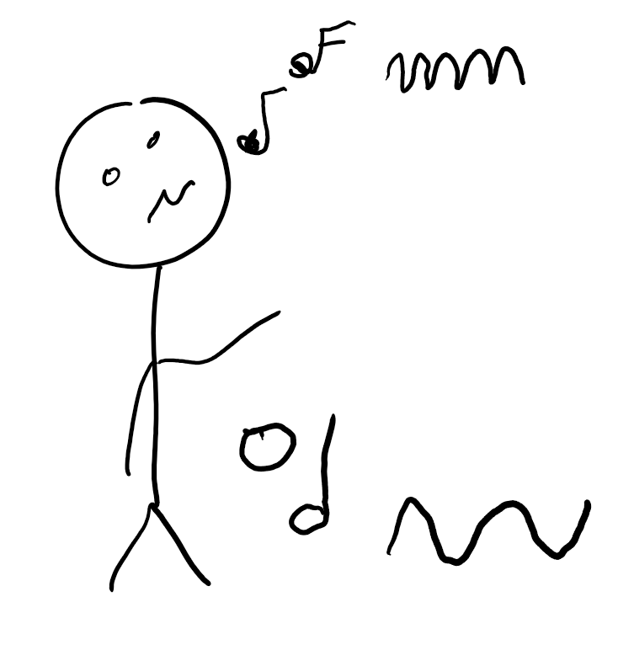
Pitch? What’s that? haha, I can’t sing that’s the joke
Your ears hear different sounds or “pitches” based on the frequency of the sound wave.
Higher frequencies mean higher pitches.
What does it mean for wavelength then?

Slide 14
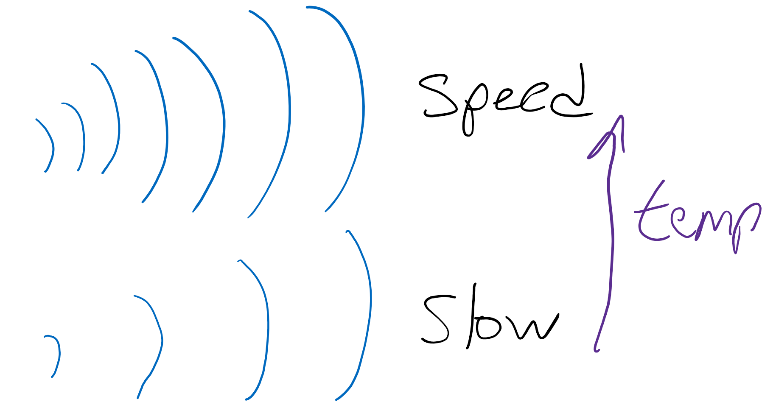
Wanna do the math?
Too bad, here’s the math:
The speed of sound is 331 m/s at 0 degrees celsius.
At room temperature (25 degrees celsius), it’s closer to 346 m/s.

Slide 15
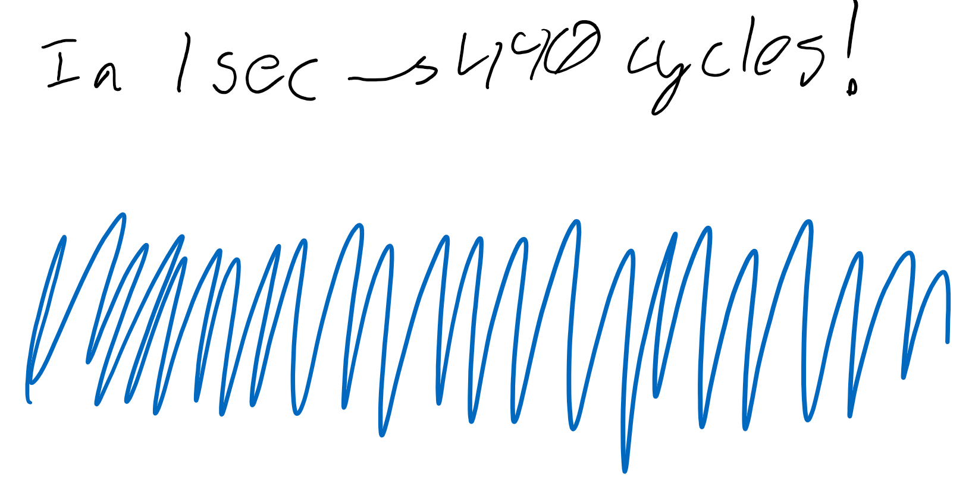
More math eew
An A4 note (close to the middle of a piano, and the note most bands use to tune instruments) is 440 hertz. If sound moves at 346 m/s, how can I calculate the wavelength?

Slide 16
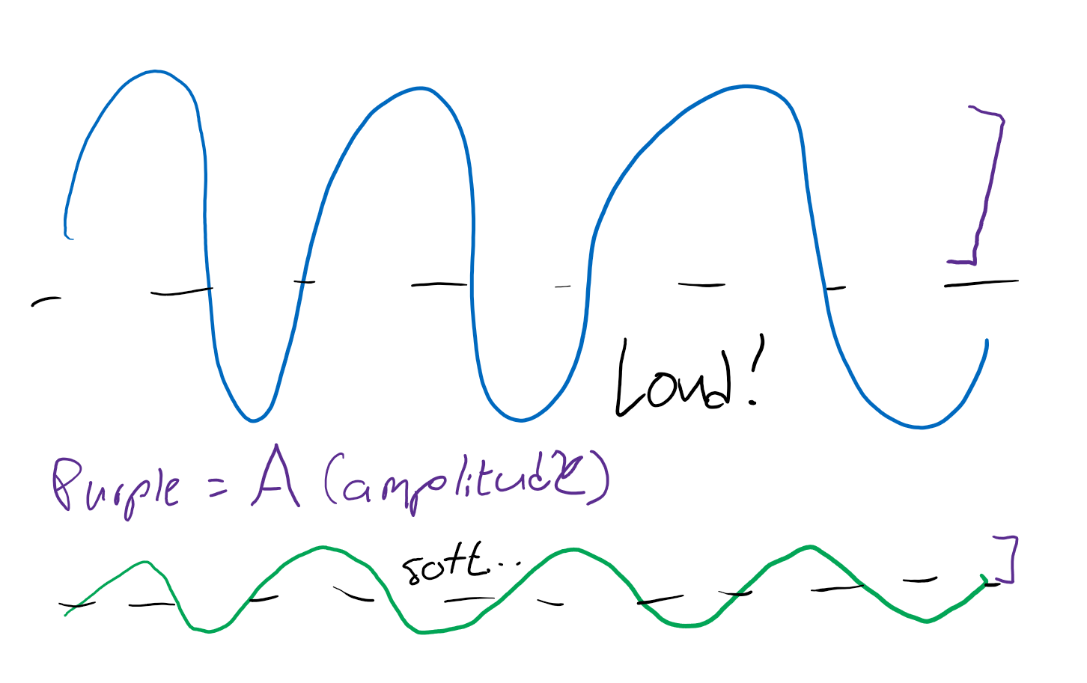
Dynamics (loud and softness)
How dramatic the compression and rarefactions are compared to each other determines how much your eardrum vibrates, and thus how loud it is! The amount you “stretch” is called “amplitude.”

Slide 17
Review
What is pitch?
Amplitude?
If a note is played that has frequency 220 hertz at 181.6 degrees celsius (very hot uh oh), meaning sound travels at 440 m/s, what is the wavelength?

Slide 18
Resonance

Slide 19
Wave interaction
Top: a wave made on a string bouncing back
Bottom: waves that bounce back/move forward can interact with other waves, making weird waves

Slide 20
Standing wave
The waves interact “just right” to make the wave just to kind of “stand in place”

Slide 21
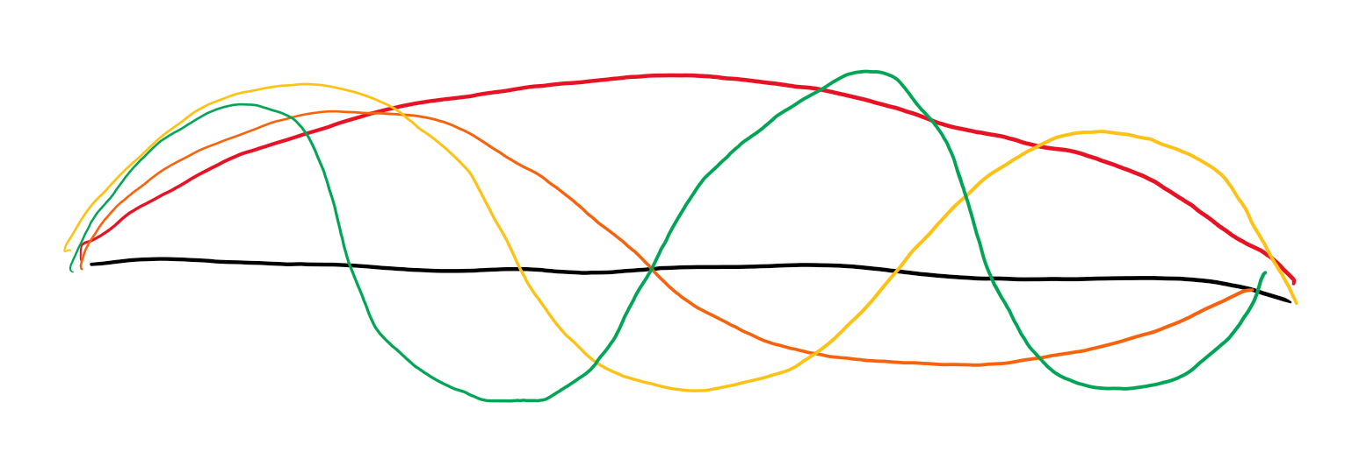
Standing waves 2.0
Notice that the wave has to be a certain wavelength to make this “standing wave.” The waves (in red/orange/yellow/green) for a guitar string (in black) have a whole number of “half-cycles” on the entire string. If λ is fixed, what about f?

Slide 22
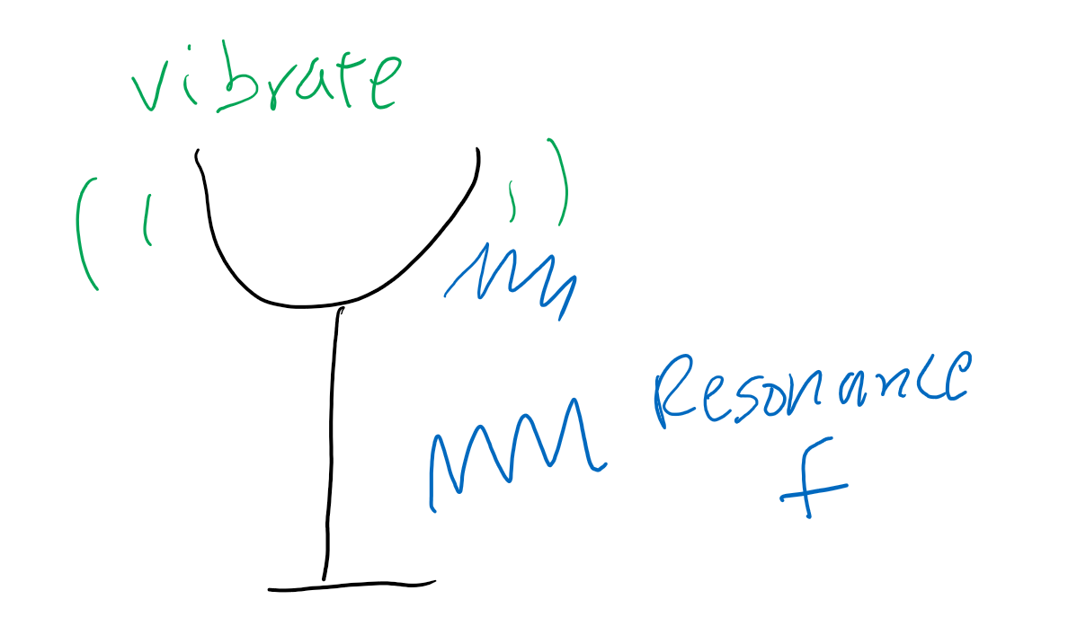
Resonance
Like a guitar string, all objects have some frequency that forms a standing wave. This is its resonance frequency. When the object is exposed to its resonance frequency, it starts vibrating!

Slide 23
Review
How do waves interact?
What is a standing wave?
What is resonance?
How can an opera singer break a glass with their voice?

